Slide 1
Software Quality Assurance and Testing Technology
1st Semester, Fall 2022
Xiaoping CHE (xpche@bjtu.edu.cn)
Associate Professor
School of Software Engineering
Beijing Jiaotong University

Slide 2
Rules
Project 20%
Assignments 40%
Final Exam 40%

Slide 3
How
16 Weeks Plan
Week 1: The basic concepts and theories of testing
Week 2-3: Principles of Testing
Week 4-5: Requirements and test case management
Week 6-7: Design of Test Cases
Week 8: Unit Testing
Week 9: Integration Testing
Week 10-11: System Testing
Week 12: Regression Testing
Week 13-14: Software Testing Management
Week 15: International and Local Testing
Week 16: Future of Testing

Slide 4

How
References
Ron Patton, Software Testing (2th Edition)
Glenford J. Myers, The Art of Software Testing (3rd Edition)
Gerald M. Weinberg, Perfect Software

Slide 5
Short Review

Slide 6
Test Cycle
Test
cases
Execution of cases
Additional tests
Results
Suspected causes
Regression tests
Evaluation
Corrections
Identified causes
Debugging

Slide 7
What is Testing
Level of detail
system
integration
module
unit
security
Accessibility
robustness
white box
black box
performance
usability
reliability
functional behaviour
Characteristics

Slide 8
Introduction
Software Fault : A static defect in the software (i.e., defect, bug)
public static void CSta (int [ ] numbers)
{
int length = numbers.length;
double mean, sum;
sum = 0.0;
for (int i = 1; i < length; i++)//i=0
{
sum += numbers [ i ];
}
mean = sum / (double) length;
System.out.println ("mean: " + mean);
}
Fault

Slide 9
Introduction
Software Error : An incorrect internal state that is the manifestation of some fault
public static void CSta (int [ ] numbers)
{
int length = numbers.length;
double mean, sum;
sum = 0.0;
for (int i = 1; i < length; i++)//i=0
{
sum += numbers [ i ];
}
mean = sum / (double) length;
System.out.println ("mean: " + mean);
}
Test Input: [3,4,5]
Error
sum=3+4+5
sum=4+5

Slide 10
Introduction
Software Failure : External, incorrect behavior with respect to the requirements or other description of the expected behavior
public static void CSta (int [ ] numbers)
{
int length = numbers.length;
double mean, sum;
sum = 0.0;
for (int i = 1; i < length; i++)//i=0
{
sum += numbers [ i ];
}
mean = sum / (double) length;
System.out.println ("mean: " + mean);
}
Test Input: [3,4,5]
sum=3+4+5
sum=4+5
failure
mean=4
mean=3

Slide 11
Introduction
Sources of Problems
Requirements Definition: Erroneous, incomplete, inconsistent requirements.
Design: Fundamental design flaws in the software.
Implementation: Mistakes in chip fabrication, wiring, programming faults, malicious code.
Support Systems: Poor programming languages, faulty compilers and debuggers, misleading development tools.

Slide 12
Introduction
Sources of Problems (Cont’d)
Inadequate Testing of Software: Incomplete testing, poor verification, mistakes in debugging.
Evolution: Sloppy redevelopment or maintenance, introduction of new flaws in attempts to fix old flaws, incremental escalation to inordinate complexity.

Slide 13
Introduction
Adverse Effects of Faulty Software
Communications: Loss or corruption of communication media, non delivery of data.
Space Applications: Lost lives, launch delays.
Defense and Warfare: Misidentification of friend or foe.

Slide 14
Introduction
Adverse Effects of Faulty Software (Cont’d)
Transportation: Deaths, delays, sudden acceleration, inability to brake.
Safety-critical Applications: Death, injuries.
Electric Power: Death, injuries, power outages, long-term health hazards (radiation).

Slide 15
Introduction
Adverse Effects of Faulty Software (Cont’d)
Money Management: Fraud, violation of privacy, shutdown of stock exchanges and banks, negative interest rates.
Control of Elections: Wrong results (intentional or non-intentional).
Control of Jails: Technology-aided escape attempts and successes, accidental release of inmates, failures in software controlled locks.
Law Enforcement: False arrests and imprisonments.

Slide 16
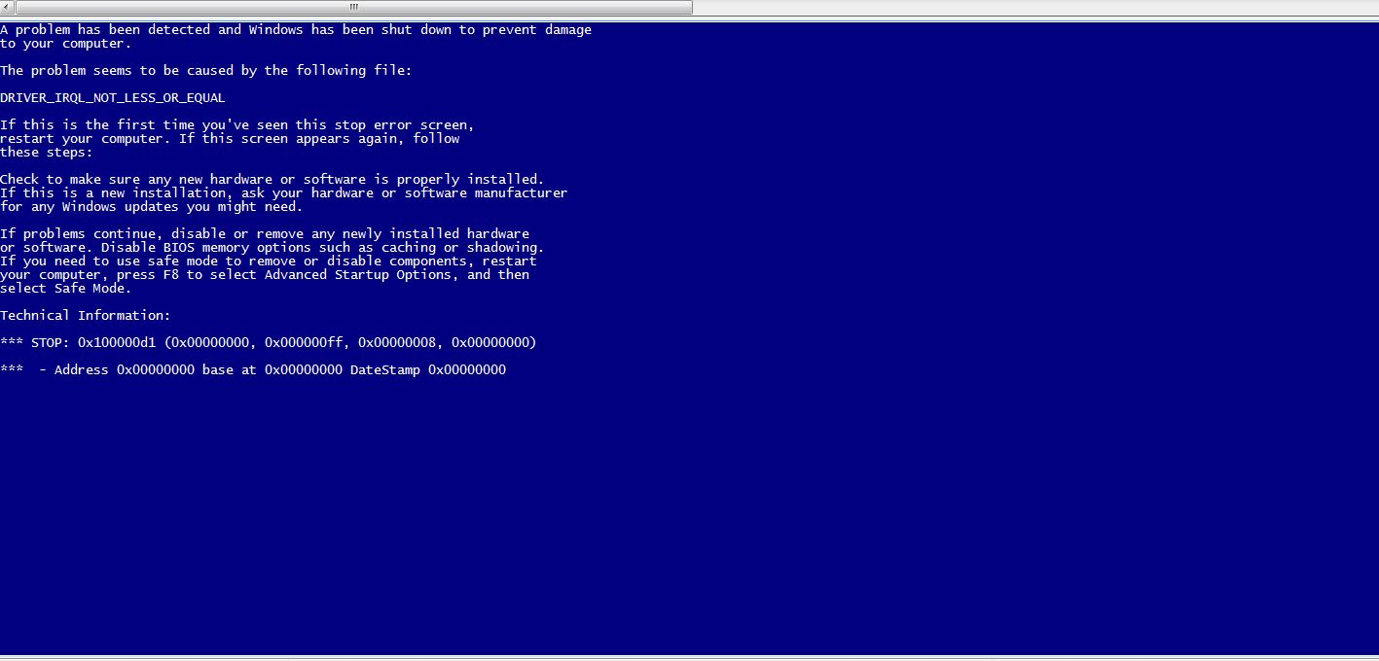
Introduction
Bug

Slide 17
Introduction
Bug in Space Code
Project Mercury’s FORTRAN code had the following fault:
DO I=1.10 instead of ... DO I=1,10
The fault was discovered in an analysis of why the software did not seem to generate results that were sufficiently accurate.
The erroneous 1.10 would cause the loop to be executed exactly once!

Slide 18

Introduction
Bitcoin
Launched in 2010, Japanese bitcoin exchange, Mt. Gox, was the largest in the world.
After being hacked in June, 2011, Mt. Gox stated that they’d lost over 850,000 bitcoins (worth around half a billion US dollars at the time of writing).

Slide 19
Introduction
Bitcoin
Although around 200,000 of the bitcoins were recovered, Mark Karpeles admits “We had weaknesses in our system, and our bitcoins vanished.”

Slide 20
Introduction
Discussion …
Have you heard of other software bugs?
In the media?
From personal experience?
Does this embarrass you as a future software engineer?

Slide 21
Introduction
System Functional requirements
Other software requirements
Customer requirements Specification
Unit Test
Design Specification
User Environment
Unit Test
Components
Integration Test
Function Test
System Test
Acceptance Test
Installation Test
Integrated modules
Functioning system
Verified, validated software
Accepted test
System in use
Unit Test

Slide 22
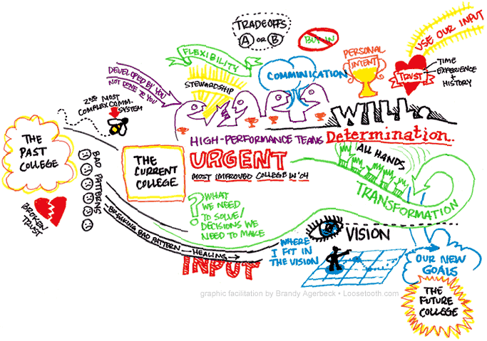
Introduction
Specification “if you can’t say it, you can’t do it”
not written.
not thorough enough.
constantly changing.
not communicated to the entire team in a timely manner.

Slide 23
Introduction
Specification “if you can’t say it, you can’t do it”
You have to know what your product is before you can say if it has a bug.
A specification defines the product being created and includes:
Functional requirements that describes the features the product will support. E.g., on a word processor
Save, print, check spelling, change font, …
Non-functional requirements are constraints on the product. E.g,
Security, reliability, user friendliness, platform, …

Slide 24
Introduction
A software bug occurs when at least one of these rules is true
The software does not do something that the specification says it should do.
The software does something that the specification says it should not do.
The software does something that the specification does not mention.
The software does not do something that the product specification does not mention but should.
The software is difficult to understand, hard to use, slow …

Slide 25
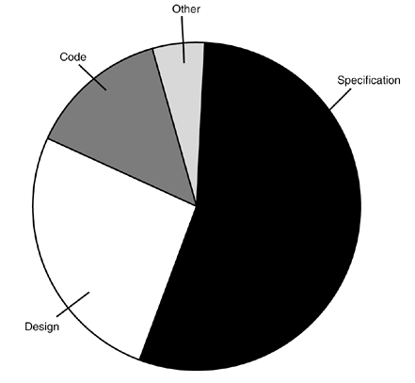
Introduction
Most bugs are not because of mistakes in the code …
Specification (~= 55%)
Design (~= 25%)
Code (~= 15%)
Other (~= 5%)

Slide 26
Introduction
Relative cost of bugs “bugs found later cost more to fix”
Cost to fix a bug increases exponentially (10^{x})
i.e., it increases tenfold as time increases
E.g., a bug found during specification costs $1 to fix.
… if found in design cost is $10
… if found in code cost is $100
… if found in released software cost is $1000

Slide 27
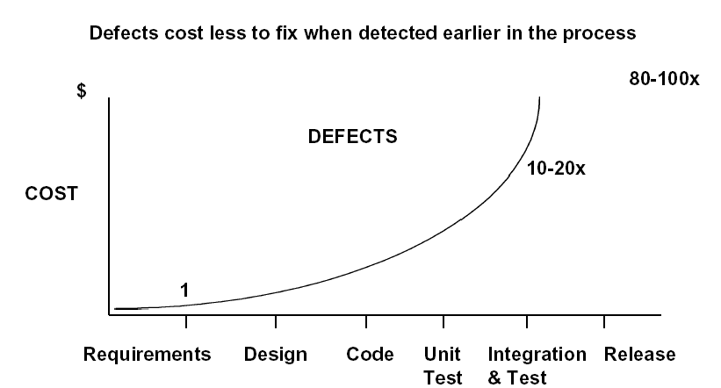
Introduction

Slide 28
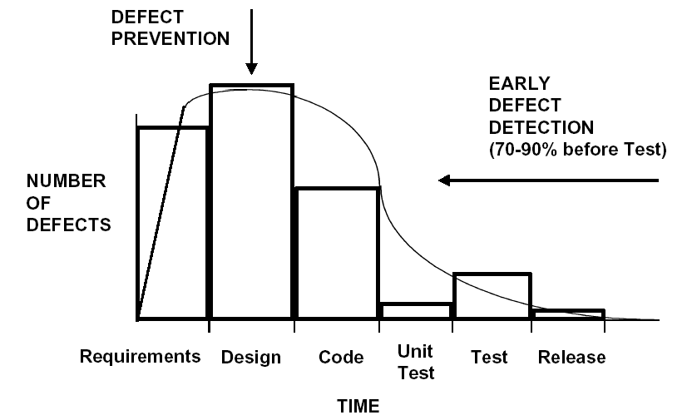
Introduction

Slide 29
The Cost of bugs
Introduction

Slide 30
Introduction
Bug Free Software
Software is in the news for the wrong reason
Security breach, Mars Lander lost, hackers getting credit card information, etc.
Why can’t software engineers develop software that just works?
As software gets more features and supports more platforms it becomes increasingly difficult to make it create bug-free.

Slide 31
Introduction
Discussion …
Do you think bug free software is unattainable?
Are their technical barriers that make this impossible?
Is it just a question of time before we can do this?
Are we missing technology or processes?

Slide 32
Introduction
Goal of a software tester
… to find bugs
… as early in the software development processes as possible
… and make sure they get fixed.
Advice: Be careful not to get caught in the dangerous spiral of unattainable perfection.

Slide 33
DEBUGGING vs. TESTING
TESTER DEBUGGER
Developer Developer
Test team Analyst
QA team
End user
THERE IS A FUNDAMENTAL CONFLICT BETWEEN THESE ROLES

Slide 34
TESTING
The operation of a system or application under controlled conditions and the evaluation of results with the intent of finding errors.
Should include normal and abnormal conditions
Testing intentionally attempts to make things go wrong to determine:
if things happen when they shouldn’t
if things don’t happen when they should
Oriented towards “detection”

Slide 35
DEBUGGING
DEBUGGING starts with an identified error and is the process of locating what is causing the bug and correcting the flaw.
It is NOT the process of showing that a bug exists.
Oriented towards “correction”.

Slide 36
Introduction
What to look for when interviewing someone for the position of software tester
Are they explorers?
Are they troubleshooters?
Are they relentless?
Are they creative?
Are they perfectionists (within reason)?
Do they exercise good judgment?
Are they tactful and diplomatic?
Are they persuasive?

Slide 37
Introduction
You now know …
… what is a bug
… the relationship between specification and bugs
… the cost of a bug relative to when it is found
… the unattainable goal of perfect software
… the goal of the software tester
… valuable attributes of a software tester

Slide 38
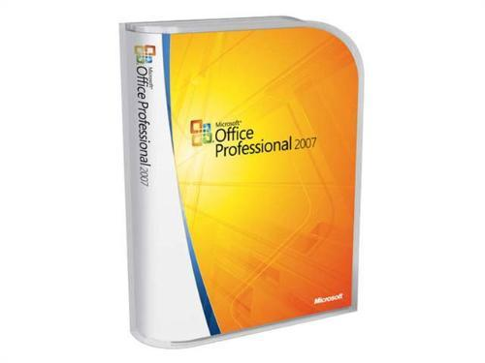
Principle of Testing
Software is …
Requirements specification documents
Design documents
Source code
Test suites and test plans
Interfaces to hardware and software operating environment
Internal and external documentation
Executable programs and their persistent data

Slide 39
Principle of Testing
Software is …
ISO Standards of Software
The ISO/IEC 25000 series of standards
ISO/IEC 25000 - Guide to SQuaRE: Provides the SQuaRE architecture model, terminology, documents overview, intended users and associated parts of the series as well as reference models.
ISO/IEC 25001 - Planning and Management: Provides requirements and guidance for a supporting function which is responsible for the management of software product requirements specification and evaluation.
ISO/IEC 25010 - System and software quality models: Describes the model, consisting of characteristics and subcharacteristics, for software product quality, and software quality in use.
ISO/IEC 25012 - Data Quality model: defines a general data quality model for data retained in a structured format within a computer system. It focuses on the quality of the data as part of a computer system and defines quality characteristics for target data used by humans and systems.

Slide 40
Principle of Testing
Software is …
ISO Standards of Software
ISO/IEC 25020 - Measurement reference model and guide: Presents introductory explanation and a reference model that is common to quality measure elements, measures of software product quality and quality in use. Also provides guidance to users for selecting or developing, and applying measures.
ISO/IEC 25021 - Quality measure elements: Defines a set of recommended base and derived measures, which are intended to be used during the whole software development life cycle. The document describes a set of measures that can be used as an input for the software product quality or software quality in use measurement.
ISO/IEC 25022 - Measurement of quality in use: Describes a set of measures and provides guidance for measuring quality in use.

Slide 41
Principle of Testing
Software is …
ISO Standards of Software
ISO/IEC 25023 - Measurement of system and software product quality: Describes a set of measures and provides guidance for measuring system and software product quality.
ISO/IEC 25024 - Measurement of data quality: Defines quality measures for quantitatively measuring data quality in terms of characteristics defined in ISO/IEC 25012.
ISO/IEC 25030 - Quality requirements: Provides requirements and guidance for the process used to develop quality requirements, as well as requirements and recommendations for quality requirements.
ISO/IEC 25040 - Evaluation reference model and guide: Contains general requirements for specification and evaluation of software quality. Provides a framework for evaluating quality of software product and states the requirements for methods of software product measurement and evaluation.

Slide 42
Principle of Testing
Software is …
ISO Standards of Software
ISO/IEC 25041 - Evaluation guide for developers, acquirers and independent evaluators: Provides requirements, recommendations and guidelines for developers, acquirers and independent evaluators of the system and software product.
ISO/IEC 25042 - Evaluation modules: Defines the structure and content of the documentation to be used to describe an evaluation module. These evaluation modules contain the specification of the quality model (i.e. characteristics, subcharacteristics and corresponding product or quality in use measures), the associated data and information about its application.
ISO/IEC 25045 - Evaluation module for recoverability: Provides the specification to evaluate the subcharacteristic of recoverability defined under the characteristic of reliability of the quality model.

Slide 43
Principle of Testing
Software is …
ISO Standards of Software
But how about User Experience
ISO 9241-210:2010(en) Ergonomics of human-system interaction — Part 210: Human-centred design for interactive systems

Slide 44
Principle of Testing
The fact is …
We care about User’s functional behavior
We don’t care about User’s feeling

Slide 45
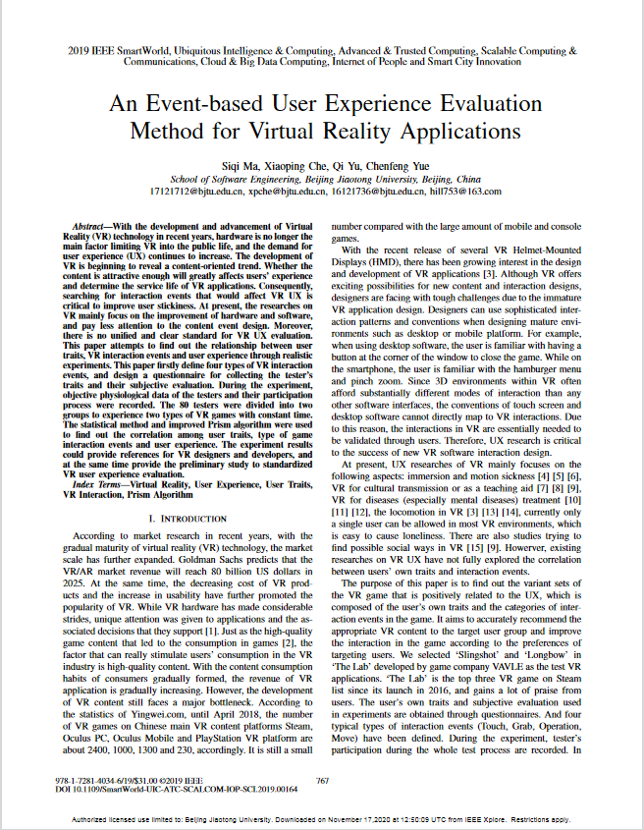
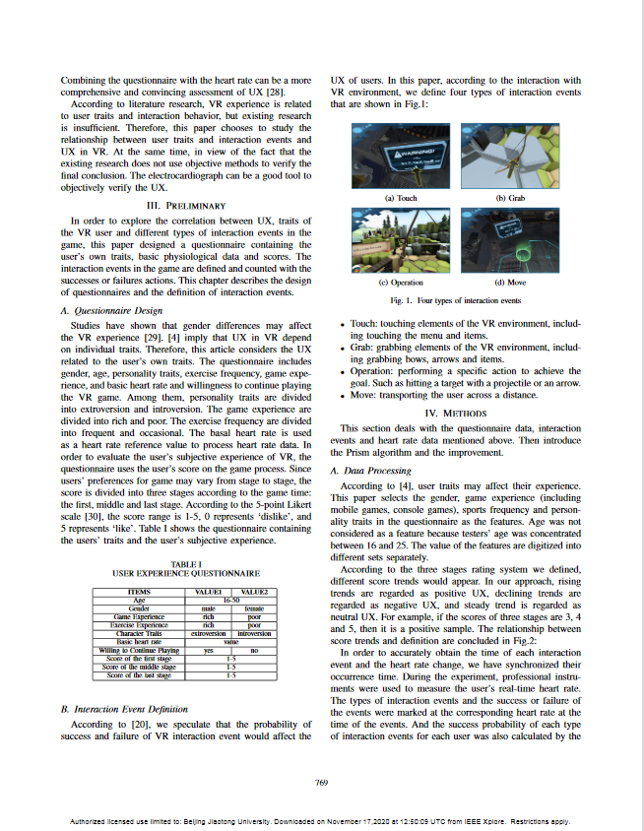
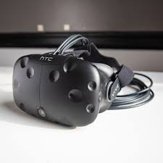
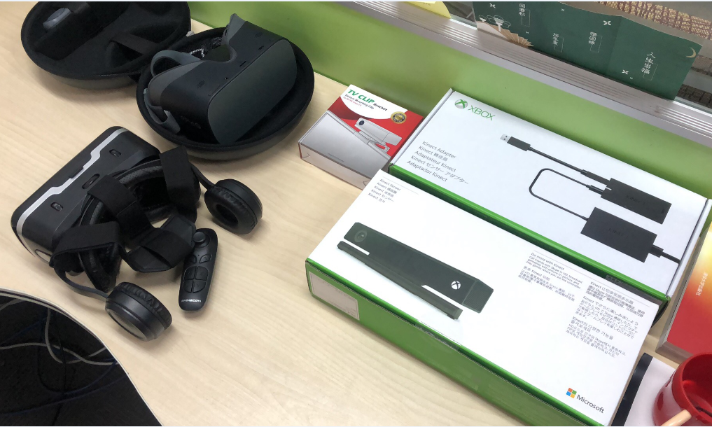
Extra Rules
Keywords:
Testing; Virtual Reality;
User Experience;
Human Computer Interaction;
A technical paper 96%- 100%
Requirements: English, 6 pages, Double Column, Original
A free ticket to attend a conference in China/Foreign Country.

Slide 46
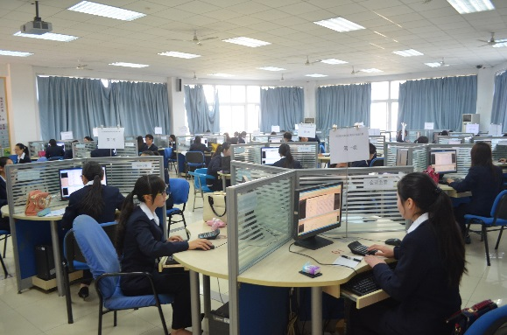
Principle of Testing
Software effort
Specification
Product reviews
Design
Scheduling
Feedback
Competitive information
acquisition
Test planning
Customer surveying
Usability data gathering
Look and feel specification
Software architecture
Programming
…

Slide 47
Product Components
Customer Requirements (Surveys, competitive info, Feedback)
MRD (Task/Feature description, Usability Data)
Specifications
Schedule
Design Docs (Architecture, Feature implementation, Interface agreement)
Test Documents (Plans, test cases, QA Milestone reports)
Online help
Release Notes / Read Me
Release packages

Slide 48
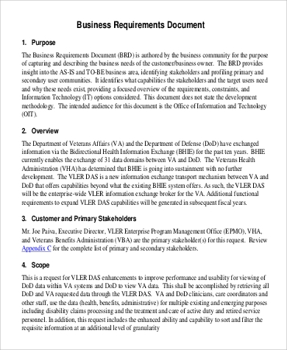
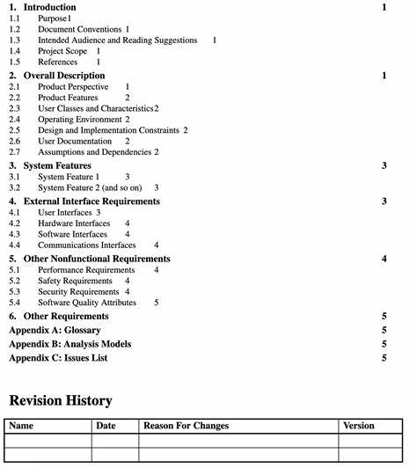
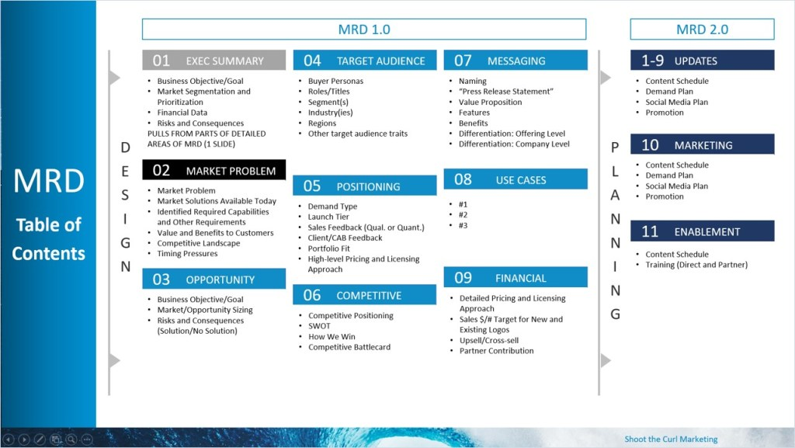
Product Components

Slide 49
Product Components
Customer Requirements (Surveys, competitive info, Feedback)
MRD (Task/Feature description, Usability Data)
Specifications
Schedule
Design Docs (Architecture, Feature implementation, Interface agreement)
Test Documents (Plans, test cases, QA Milestone reports)
Online help
Release Notes / Read Me
Release packages

Slide 50
Principle of Testing
Customer requirements
The software development team must determine what the customer wants.
How can you do this?
Guess?
Collect detailed information from surveys?
Get feedback from a previous version of the software?
Read reviews in magazines?
Get information about the competition?
Other ways?
The collected data is used to guide the specification effort.

Slide 51
Writing MRD AND SPEC
Principle of Testing
a project management issue - but a difficult one
For our purposes, verifiability is critical:
(bad) The system should be easy to use and user errors should be minimal.
(better) Experienced controllers should be able to use all the system functions after a total of two-hours of training.
After training, the average number of errors made by the experienced controllers will not exceed two per day.
But there are still problems. What are they?

Slide 52
Principle of Testing
Specification “If you don't know where you're going any road will take you there”
The specification takes the data from the customer requirements and other sources and defines:
The features of the software (functional requirements).
The constraints on these features (non-functional requirements).
Specifications can be:
formal (e.g., aerospace industry), rigid
informal (e.g., a .com start up), on a cocktail napkin or a whiteboard.

Slide 53
SOME WAYS TO QUANTIFY
Principle of Testing
Speed:
Processed transactions/second; user-response time; screen refresh time.
Size:
Number of bytes; number of records; number of transactions.
Ease of use:
Training time; number of help frames; define classes of users objectively

Slide 54
Principle of Testing
SOME WAYS TO QUANTIFY
Reliability:
Mean time to failure; probability of unavailability; rate of failure occurrence; availability.
Robustness:
Time to restart after failure; percentage of events causing failure; probability of data corruption on failure.
Portability:
Percentage of target-dependent statements; number of target systems.

Slide 55
Principle of Testing
Schedules
The goals of scheduling are to know:
What work needs to be completed?
How much work is left to do?
When will the work be finished?
Who will finish each task?
Other measurable queries.
A Gantt chart is a popular type of bar chart that illustrates a project schedule.

Slide 56
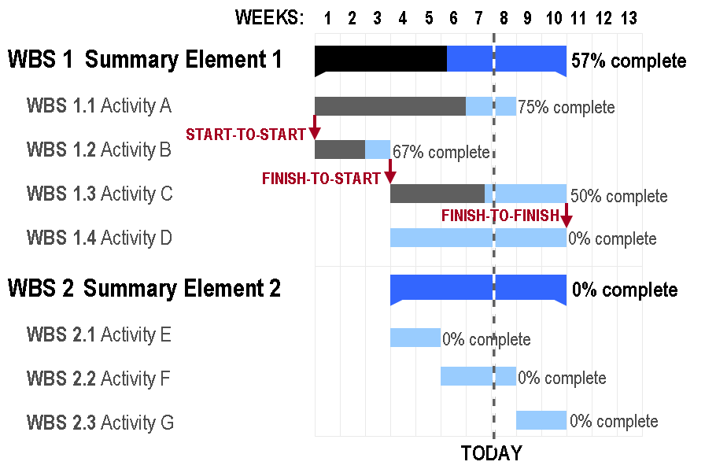
Principle of Testing
Gantt Chart

Slide 57
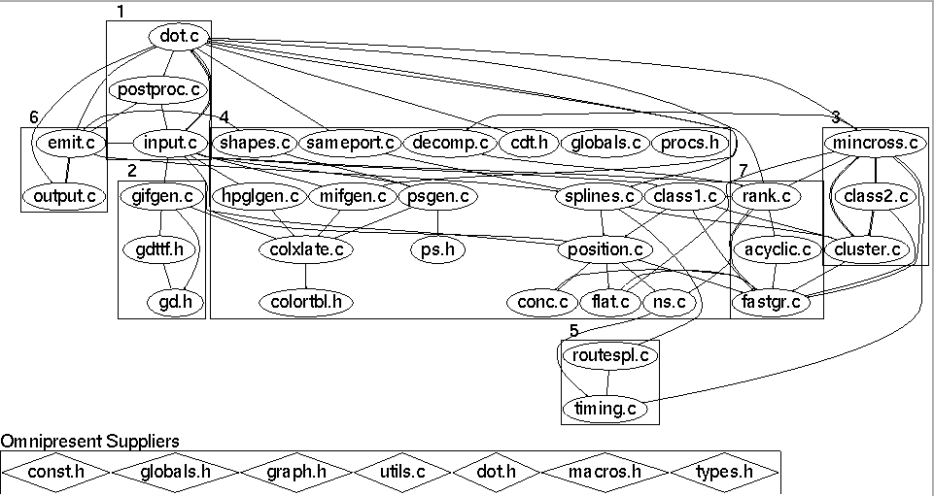
Principle of Testing
Design
Before coding begins on non-trivial software projects, a set of design documents are created to serve as blueprints.
Software Architecture
Data flow diagram
State transition diagram
Flowchart
Commented code

Slide 58
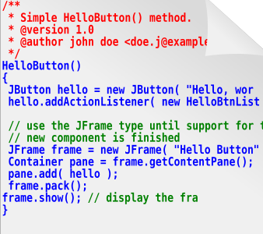
Principle of Testing
Source code … of course
The ultimate specification of the software!
‘Code is king’ philosophy is still prevalent.
Many programming languages and tools to choose from.

Slide 59
Principle of Testing
Test documents
Test plan
Quality objectives, resource needs, schedules, assignments, methods, etc.
Test cases
Inputs and expected outputs.
Bug reports
E.g., the Bugzilla web-based bug tracker.
Test tools and automation
Metrics, statistics, and summaries
Number of unresolved bugs, mean time to repair a bug, etc.

Slide 60
Principle of Testing
Software Project Staff
Project managers
Write product specification, manage the schedule, critical decision tradeoffs
Software architects, system engineers
Design the software, work closely with programmers
Programmers, developers, coders
Write code, fix bugs
Testers, quality assurance staff
Find bugs, document bugs, track progress of open bugs
Technical writers
Write manuals, on line documentation
Configuration managers, builders
Packaging and code, documents, and specifications

Slide 61
SD Team
图DEV-oriented model
DEV manager
Tester
Programmer
DOC
Management
PM
PM
Test Lead
DEV lead
DOC
Test Manager
DEV Manager
图PM-Oriented model
Tri-Model

Slide 62
To be continued… See you this week

